Slide 1
Capstone Project By Punam Shaw
Analysis on Emergency 911 Calls
Montgomery County, PA

Slide 2
Data Information
The data is taken from Kaggle website and it is about the Emergency 911 Calls made in Montgomery County, PA area.
It is a presentation in of the visualization created by Python Code. Please refer to the Word doc for Python Code references.
I have used Pandas, Numpy, Matplotlib and Seaborn for the visualization.

Slide 3
Top 5 zipcodes for 911 calls
19401.0 6979
19464.0 6643
19403.0 4854
19446.0 4748
19406.0 3174
Analysis- Once we know what the TOP 5 zip code areas were maximum emergency call are made we can take adequate measures to reduce it

Slide 4
Top 5 townships for 911 calls
LOWER MERION 8443
ABINGTON 5977
NORRISTOWN 5890
UPPER MERION 5227
CHELTENHAM 4575
Analysis- The above data shows top 5 townships along with with count of emergency calls.

Slide 5
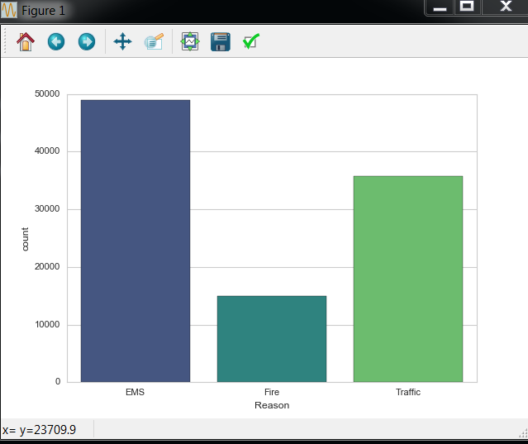
911 Emergency Calls Based on Type
EMS 48877
Traffic 35695
Fire 14920
Analysis- EMS is the Reason for which maximum emergency 911 calls are made

Slide 6
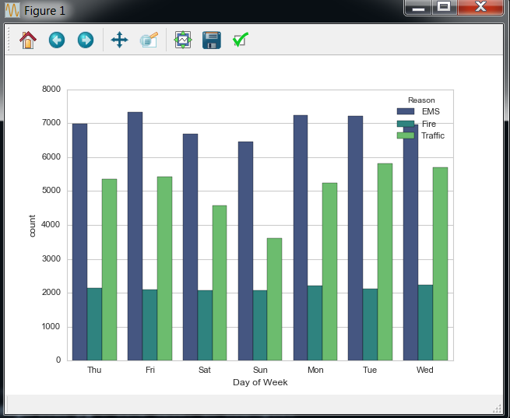
Calls based on different Reasons depending on Day of the week
Analysis- Based on the Bar Plot we can see that emergency calls are little less on Sunday. However, it is mostly same on all days of the week.

Slide 7
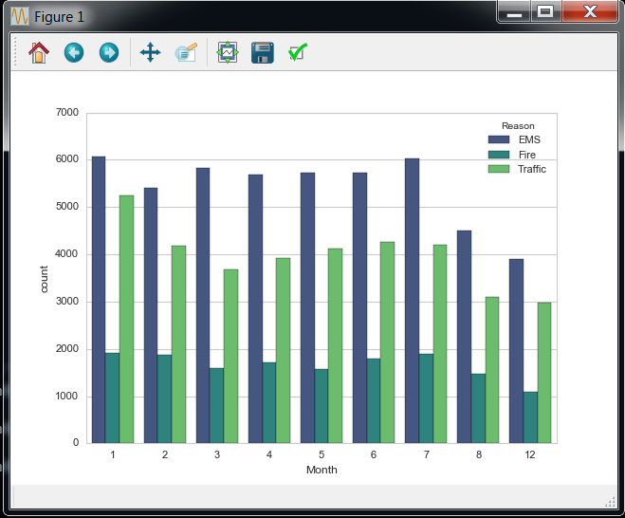
Calls based on different Reasons Monthwise
Analysis- We can from this plot that the data is missing for Month 9,10,11. We can use line plot to fill in the missing months.

Slide 8
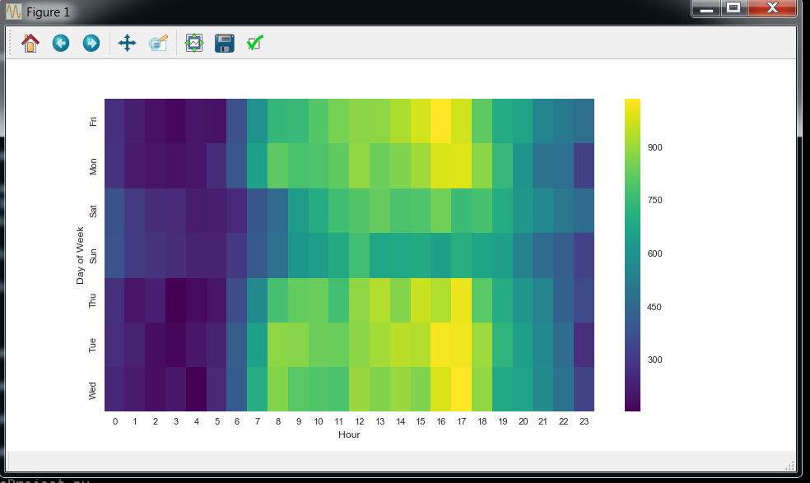
Generating Heatmaps of calls by day and hour.
Analysis: From the Heat Map we can see that the maximum emergency Calls have happened around 12:00AM to 6:00AM. Let us further create a Cluster Map to Analyze the data more.

Slide 9
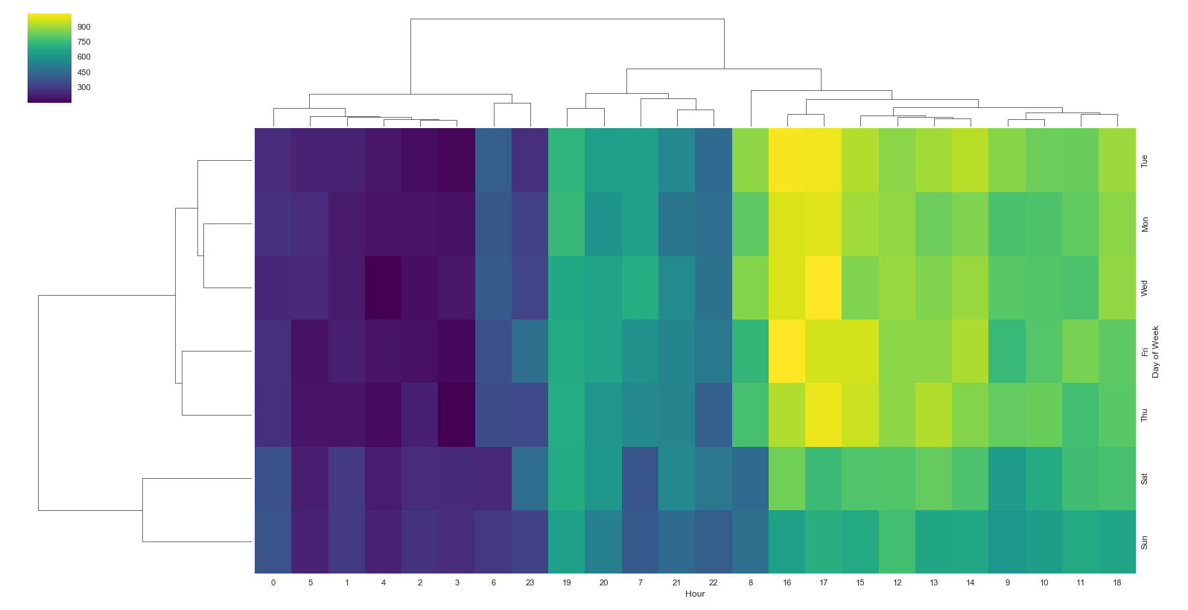
Generating Cluster Map of calls by day and hour.
Analysis- Here we can see that the maximum Emergency 911 calls have been made between 11:00pm to 6:00AM period. So, 911 officials have to be pretty alert at that time to help people the most.

Slide 10
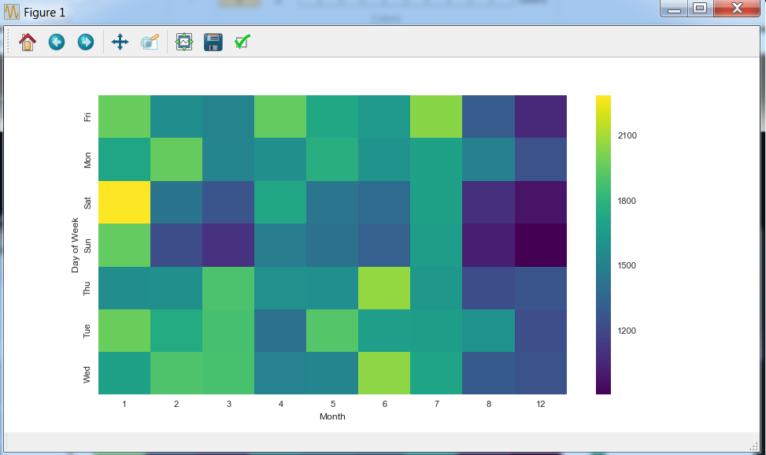
Generating Heatmaps of calls by Month
Analysis: The dark spots indicates most calls, so we can infer that August and December Month had been the peak period for most Emergency calls. Lets further understand the data using Clusters.

Slide 11
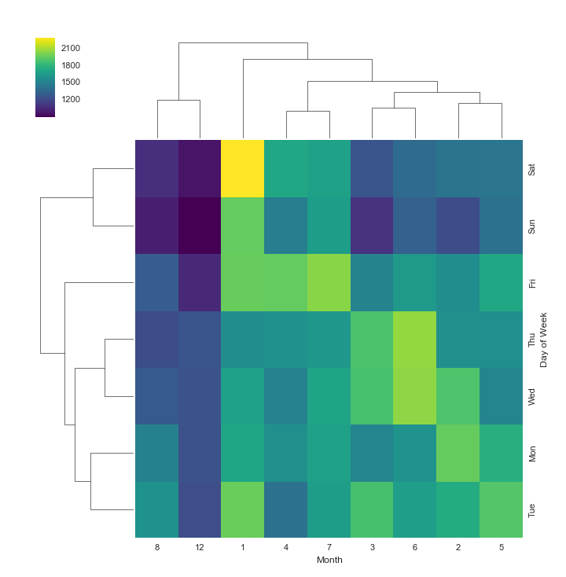
Generating Cluster Maps of calls by Month
Analysis: In the cluster Map it shows that August and December had been the peak period for the most calls and the time of the week was usually from Friday, Saturday and Sunday.

